Slide 1
Standing up to the ethical challenges of Finance, Technology and Governance to enhance Africa’s Development potentials in the 21st century
Rev Monsignor Prof Obiora Ike
Executive Director Globethics.net Geneva, Switzerland

Slide 2
Global & local challenges
A time of great challenges with unprecedented political, environmental, social and economic instability worldwide
A real concern for better governance & a call for more ethics & sustainability
Global loss of trust in political and business leaders
Technology and innovation is penetrating all sectors
New forms of job & business model e.g social entrepreneur, co-working, etc.
Youth & employees are looking for purposes at work & better jobs opportunities
Poverty reduction & wealth creation remained weak
Demand to rethink new forms of development model & policy
2

Slide 3
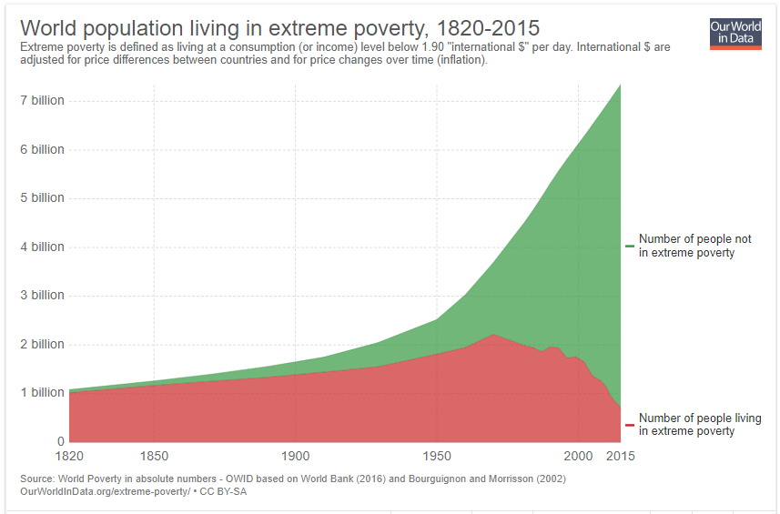
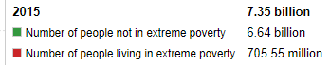
World Level of Poverty

Slide 4
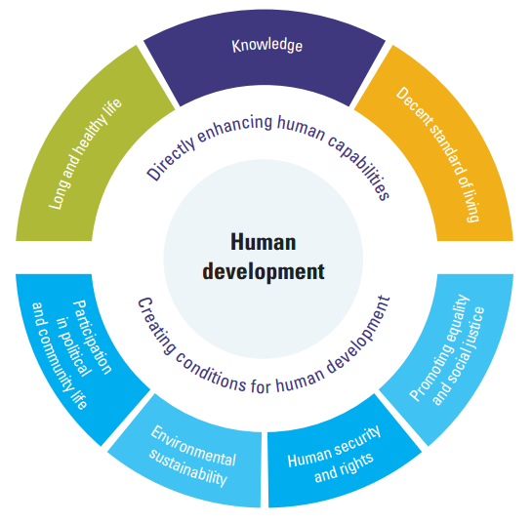
Dimensions of Human Development (HD)

Slide 5
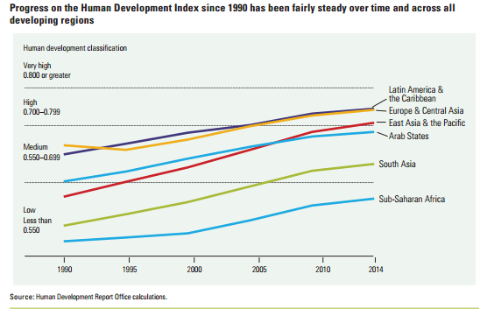
Africa holds the lowest Human Development Index in 2015

Slide 6
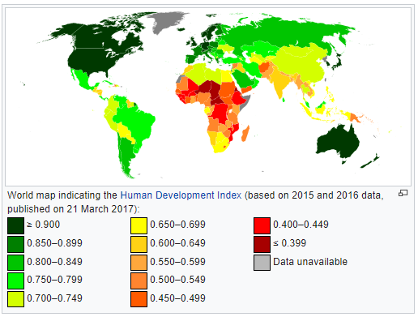
Nigeria holds the position of 152 out of 188 countries on Human Development Index

Slide 7
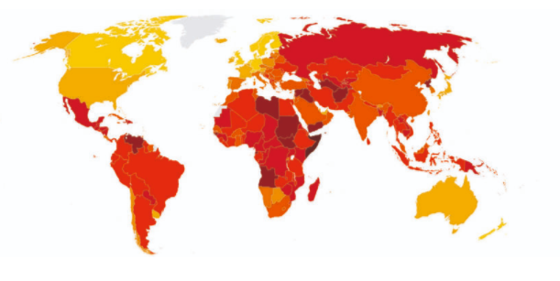
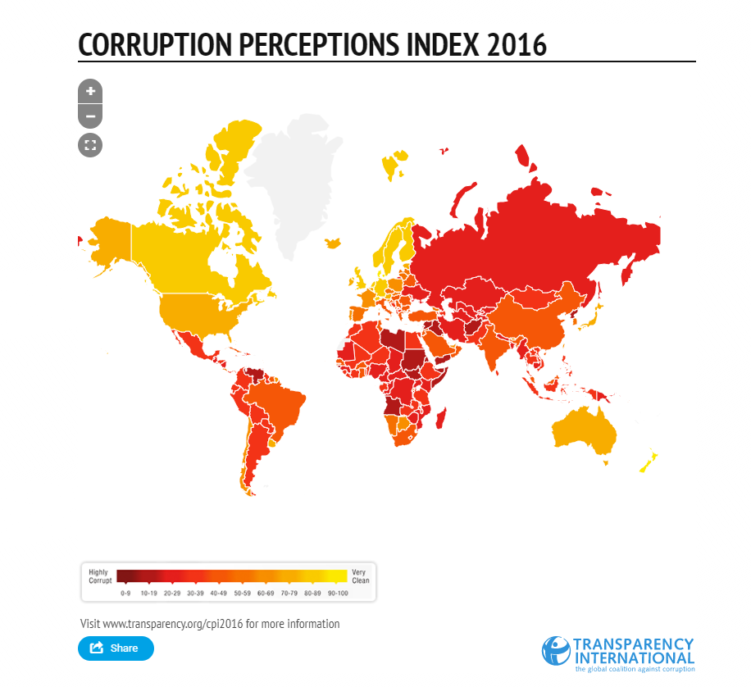
Corruption Perception Index 2017
Nigeria is ranked 148 out of 180 countries
7

Slide 8
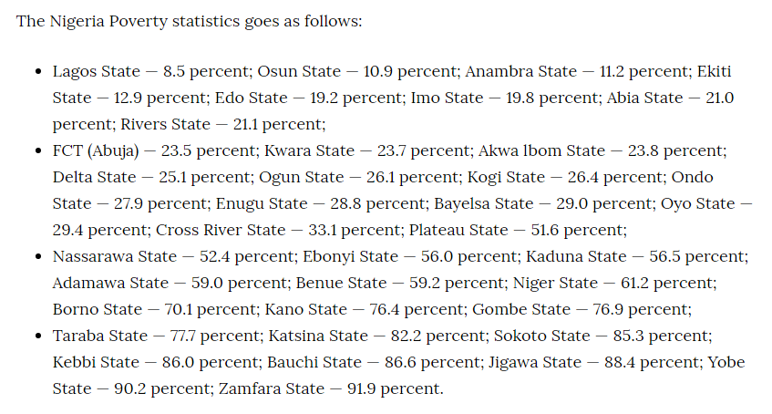
Nigeria’s Poverty rate
https://naijaquest.com/nigeria-poverty-statistics/

Slide 9
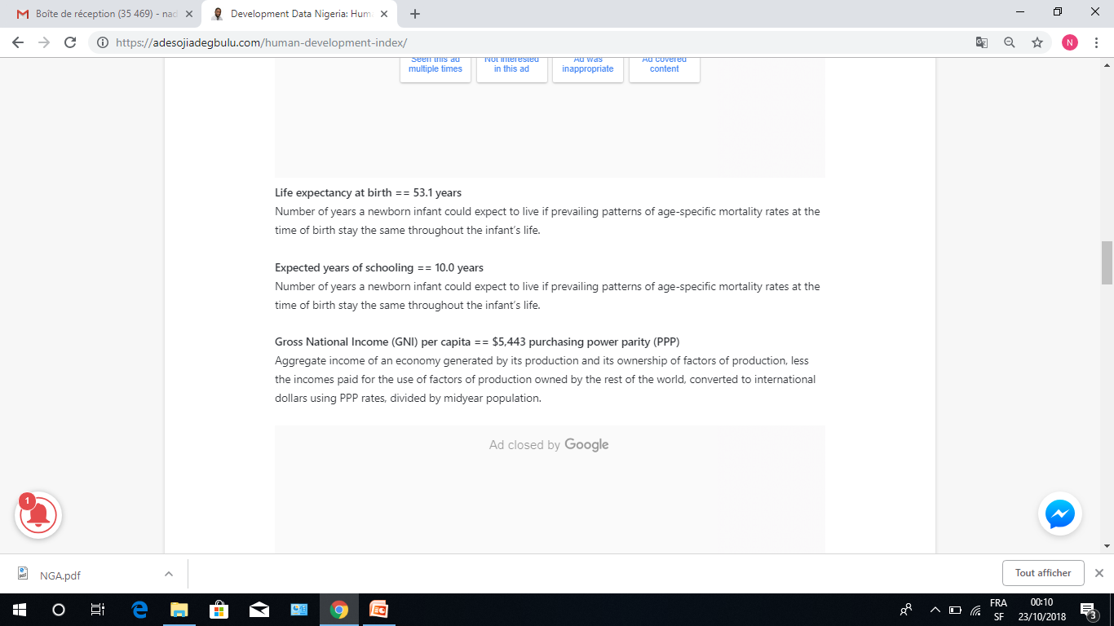
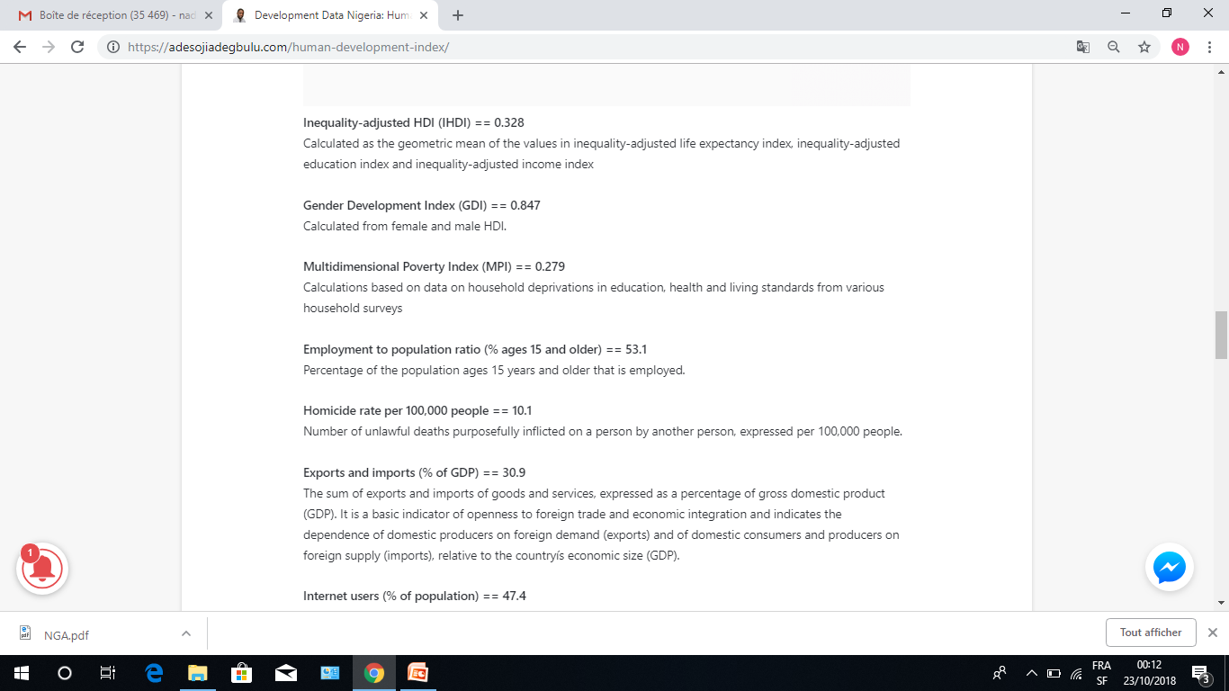
Some facts and figures for Nigeria

Slide 10
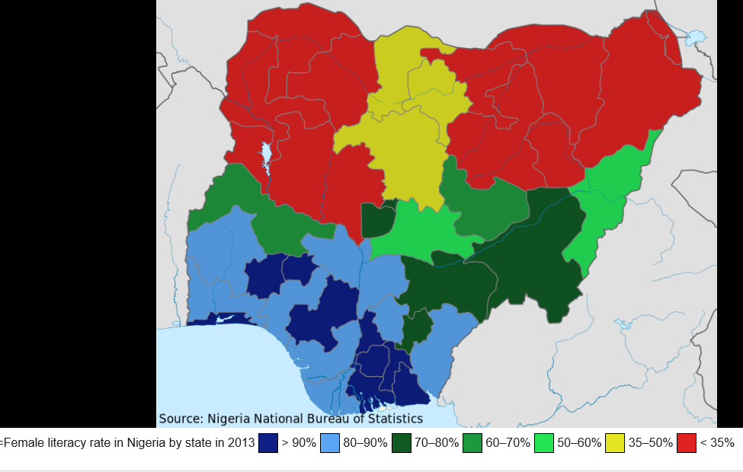
Female literacy rate in Nigeria by state in 2013
Source: Wikipedia

Slide 11
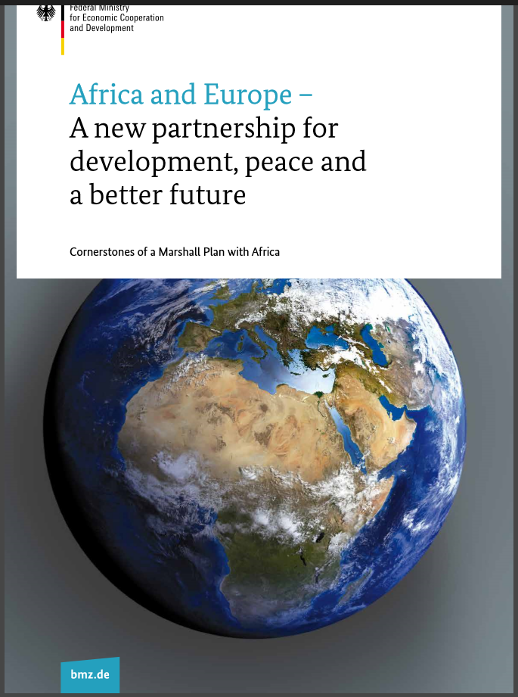
Rethinking the future of Africa at Global Level
11

Slide 12
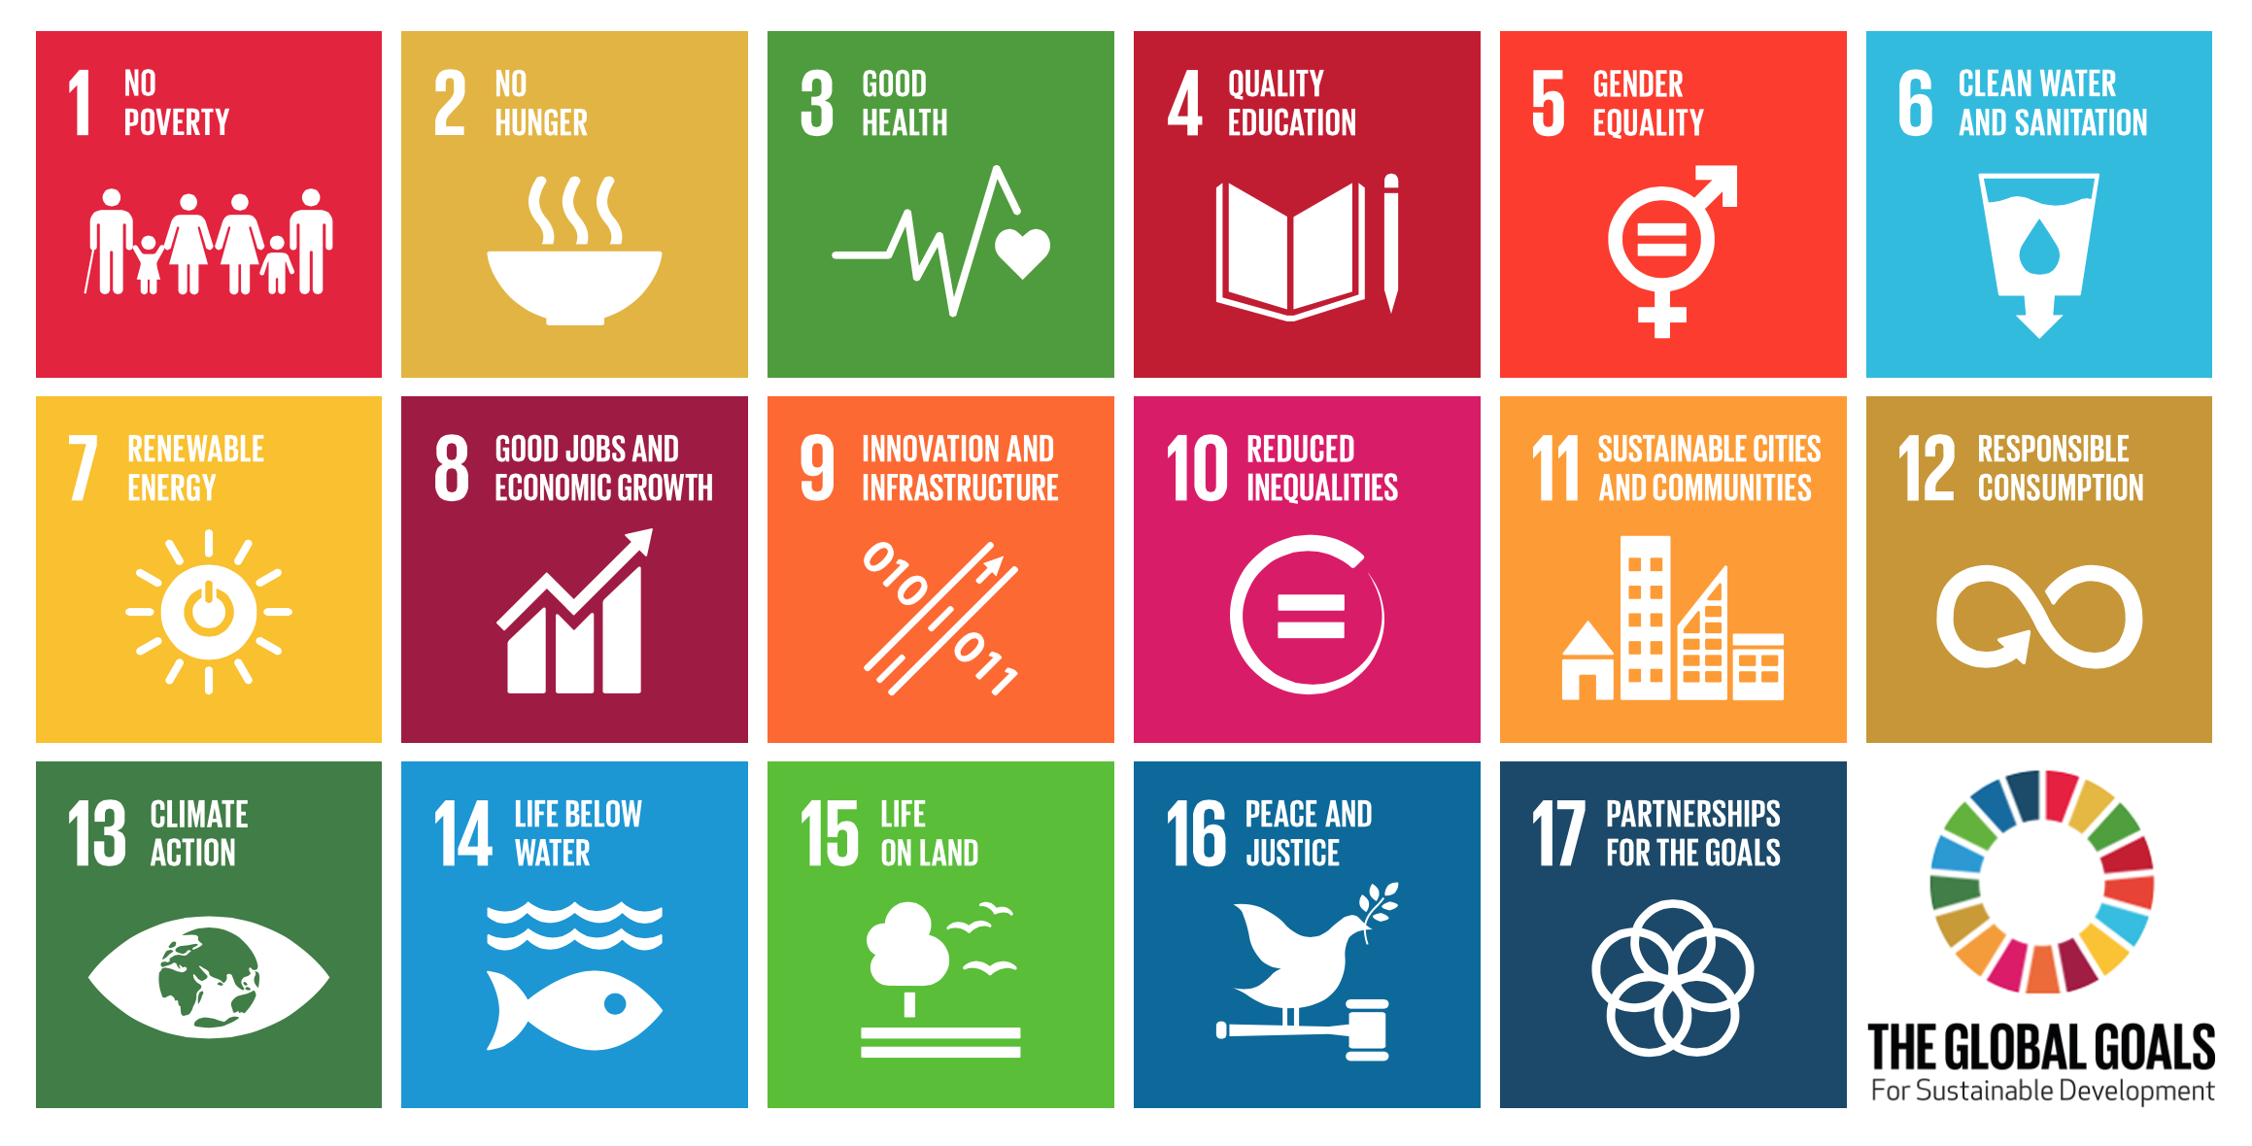
A Global Agenda - Sustainable Development Goals 2030

Slide 13


Slide 14
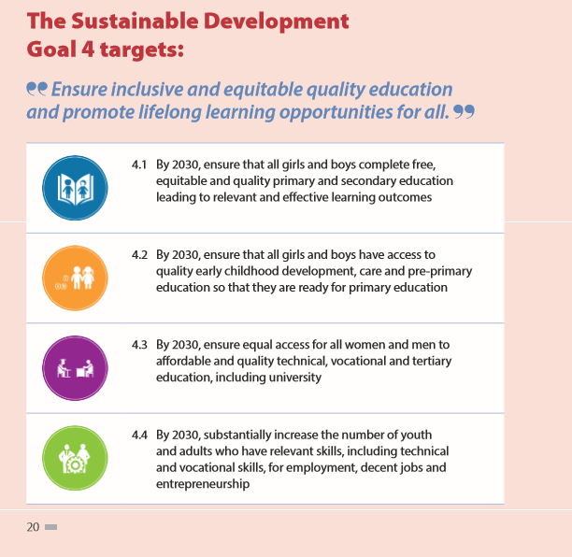

Slide 15
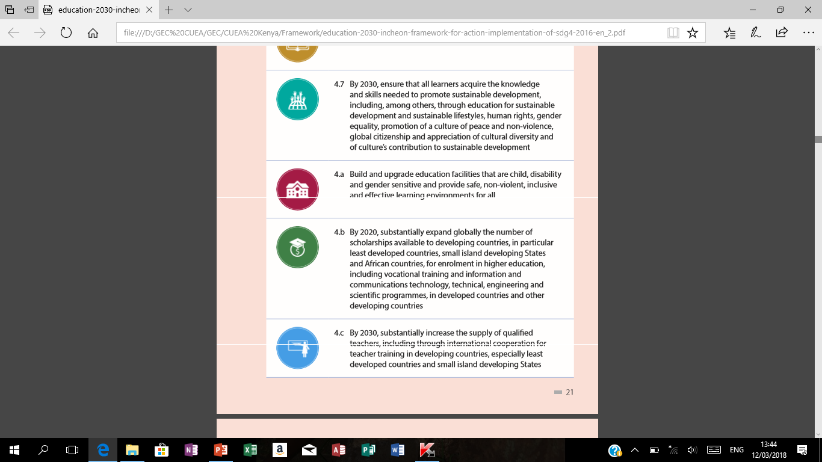

Slide 16

….Role of Universities in Developing Countries
University education is more than the next level in the learning process; it is a critical component of human development worldwide. It provides not only the high-level skills necessary for every labor market but also the training essential for teachers, doctors, nurses, civil servants, engineers, humanists, entrepreneurs, scientists, social scientists, and a myriad of other personnel. It is these trained individuals who develop the capacity and analytical skills that drive local economies, support civil society, teach children, lead effective governments, and make important decisions which affect entire societies.
Source: www.educationalpathwaysinternational.org

Slide 17
However…

Slide 18


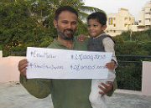
There’s No sustainable development without ethics
The future of humanity rests on some critical key points, one of which is that there can be no sustainable development universally if there are no ethical values integrated across sectors and built within the education, political, cultural, financial and technological industries at all levels.
If Facebook were a country, it would be the largest in the world with its 3 billion users from every country and generation beyond cultures, religions and ideologies. What policies, skills and resources are available not only for knowledge acquisition, but also for creating the environment for the development and application of basic ethical values and principles practically in the training of the youth, towards overall transformation?
Can any sustainable development and progress be assumed for humanity if it is devoid of education, and come to reason on this, surely an education that has strong content in values and ethics that produce leaders that are values-driven?

Slide 19
The shame of humanity in ethical gaps
Today humanity is ashamed of its inability to respect and defend human life, protect human dignity and promote the welfare of all.
The lack of responsibility and values-driven leadership in local, national and international contexts bear the clear evidence of failure.
We are all aware of the growing turmoil various people and nations face in the twenty first century and are shocked that what we thought we had achieved in previous centuries—freedom, democracy, justice, equality, tolerance, peace and economic welfare for all—are gradually eroding in these times to our dismay.

Slide 20
The first failure is not system but character
However, it is not the systems that failed first. What failed first were character and ethical principles in human agents.
Managing and including ethics at all levels of finance, technology and governance becomes a societal priority

Slide 21

Transformation as aim of the vision
The recent edition of CADMUS Journal, volume 3, Issue 4 of May 2018 mentions and some of you are already aware, “the world has entered the new Axial Age. Numerous transformations are taking place in the models of social, economic, and political activity, in projections of power and authority.
The political landscape and its relevant “content structures” (democracy and liberalism, right and left, globalisation and nationalism etc.) are acquiring new systemic qualities. If we want to avoid fighting with the ghosts of the past, it is necessary not only to take into account these transformations but examine them from within.
Who can manage the complexity of the “plurilateral” world we are stepping into? What kind of political architecture will be needed to support the nascent multi- or rather “pluripolarity”?

Slide 22

Modern times suffer from integrity deficiency
As the referred to CADMUS journal mentions, some of the current challenges include: “Bitcoin, block chain, fake news, populism, the polarization of societies, growing poverty and disparity between those who have and those who do not have, the world financial crisis, the revival of Cold War tensions, renewed proliferation of nuclear weapons, artificial intelligence, the fourth Industrial Revolution, neoliberalism, the retreat from democracy, rising intercultural tensions and fundamentalism which have all something in common”.
And we know, some of this crisis suffers from Integrity deficiency.

Slide 23
The common good is foundation
Taken together, we see institutional weakness in finance, technology, government, religious, showing a growing lack of trust or respect by citizens for established authority and institutions around the globe.
And perhaps more worrisome is a growing absence of faith in the human values that guide people; values founded on sound moral and natural reasoning, using freedom to make choices and decision that affect the common good.

Slide 24
Values and virtues set the agenda for human action
Some of these values are embedded in what we consider excellence, integrity and justice, life, respect and sharing, inclusion and responsibility, competence and accountability - and there are many others - all of which serve sustainability.
Unfortunately, a noticeable tendency is for some people to remain, as the Acton Institute mentions in its latest editorial “vulnerable to the seductions by the new gods of autonomy without community, freedom without responsibility, rights without duties, pleasure for pleasures sake, entertainment devoid of work, allegiance to a diversity that questions identity built on lifestyles that reject ethical conduct that are values-driven”.
It cannot continue like this and the youth whose future stands ahead are the most vulnerable.

Slide 25
The Practice of Ethics is action
The taste of the pudding, they say, is in the eating. How do we translate and make ethics practically present and relevant in the classroom and lives of students, teachers and professionals who emerge from higher education institutions?
We are compelled by the practice of Ethics in the market place- with the right products and the adequate prize, promoted by the right people and the correct brand of promotional material to impact the change we want for society.
It is as simple as this but the fact is that the journey has just stated – with you.

Slide 26
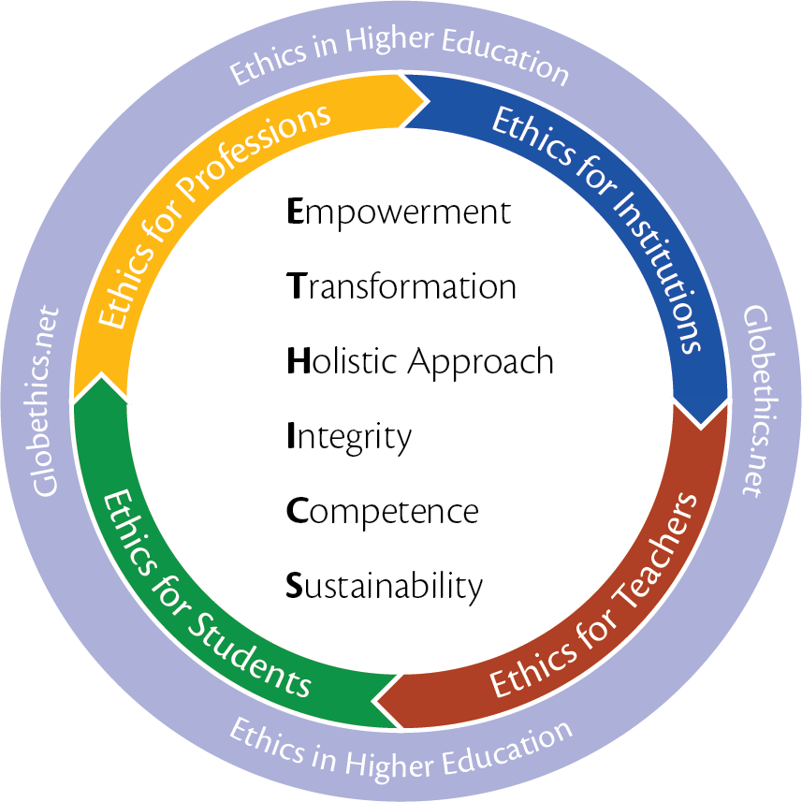
Capacity building is the way to go
We encourage capacity building at the level of institutions and by encouraging critical thinking and ethical behaviours among teachers and students.
The training concepts are based on four programmes and four resources that constitute the Globethics.net Cycle of ethics in education - all of which are in a pack for you to take home, read and engage.
The Resources include the digital Library; Publishing House, Academy and Network customised to local contexts and needs.

Slide 27
Is ethics realizable?
The most troublesome concepts are the ones we take for granted. This is not because they are familiar but because they are embedded in our way of thinking.
They roll off our tongues without our even attempting to think what they really mean. We take them axiomatically as established truths.
One of these concepts is the idea that ethics is not practicable or its integration not practicable.

Slide 28
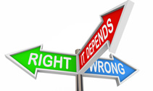
Cultural and spiritual values inspire Ethics for life
That we must once again reaffirm the cultural and spiritual values that irresistibly draw humanity into the future through ethical practices that considers the “ought” and do the right because it is right to do so.
It compels us to rediscover the underlying power behind all sciences - of literature, history, philosophy and the other humanities to restore wholeness to our highly fragmented view of the world by reuniting the objective and subjective dimensions of social reality.

Slide 29

Daily news expose unethical practices
And indeed, when you read a newspaper today, you get the impression that the growing cases of corruption, sexual harassment, abuse of power, lack for zeal for hard work, nationalist challenges confronting the globalist model have moved to the centre of political discourse.
Indeed it has, but that is part of the bad news. There is also good news.

Slide 30
The ethical challenge to leadership and governance
How can we synchronise governance with inevitable digitalisation of politics?
How can we enable decision-making mechanisms at the global level?
These questions need to be answered. Nobody will miss the train to “a bright tomorrow”. Historical time flows for everyone—we cannot hide “behind the wall” to avoid it.
No actor of a historical process can bury his head in the sand of the comfortable present, indulging in “counter-clockwise revolt”.
The future will come for everyone, but not everyone will hold an equal place in it.

Slide 31
In Summary, we must
Understand the ethical challenges of facing Finance, Technology and Governance today.
Accept these challenges across all areas
Collaborate to innovate on sustainable solutions

Slide 32
Thank you
Dankie Kea leboha Ngiyabonga
Enkosi
شكراً جداً(Shokran Gidan) merci teşekkürler ngiyabonga kealeboga baie dankie diolch yn fawr धन्यवाद(Danyavad) 謝謝(xiexie) tatenda asante sana gracias ありがとうございました Спасибо(spacibo) mazvita siyabonga medase grazie adube oshe dankjewel mulţumesc obrigado/a akwaba dalu

